Slide 1
EIT Digital Offering
IEEE & EIT Digital:
Federated Testbeds Workshop
May 3, 2016
Marko Turpeinen, Director
EIT Digital Silicon Valley Hub
@mturpeinen, @EIT_Digital

Slide 2
Notes:
EIT was established in 2008 as an independent agency within the EU.
Official call and selection of the first three KICs in 2009 and first KICs fully operational in December 2010.

Slide 3
EIT Digital locations
Silicon
Valley
Hub
Notes:
EIT Digital is a leading European open innovation organisation. Our mission is to foster digital technology innovation and entrepreneurial talent for economic growth and quality of life in Europe. We bring together entrepreneurs from a partnership of over 130 top European corporations, SMEs, start-ups, universities and research institutes.
EIT Digital invests in strategic areas to accelerate the market uptake of research-based digital technologies and to bring entrepreneurial talent and leadership to Europe. Our innovation and education activities are organised in and around our co-location centres, where students, researchers, engineers, business developers and entrepreneurs come together to drive the digitalisation of society.
EIT Digital is a Knowledge and Innovation Community of the European Institute of Innovation and Technology (EIT). Since 2010, EIT Digital is consistently mobilising talents, ideas, technologies, investments and business across Europe and beyond to stimulate disruptive digital innovation. The headquarter is in Brussels with co-location centres in Berlin, Eindhoven, London, Helsinki, Paris, Stockholm, Trento, as well as in Budapest and Madrid.

Slide 4
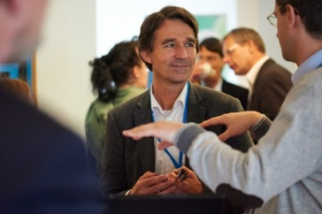
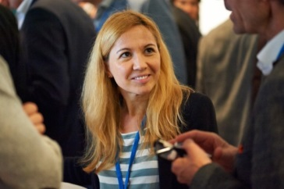
EIT Digital partners

Slide 5
entrepreneurial
education
innovation & entrepreneurship
Notes:
4 min

Slide 6
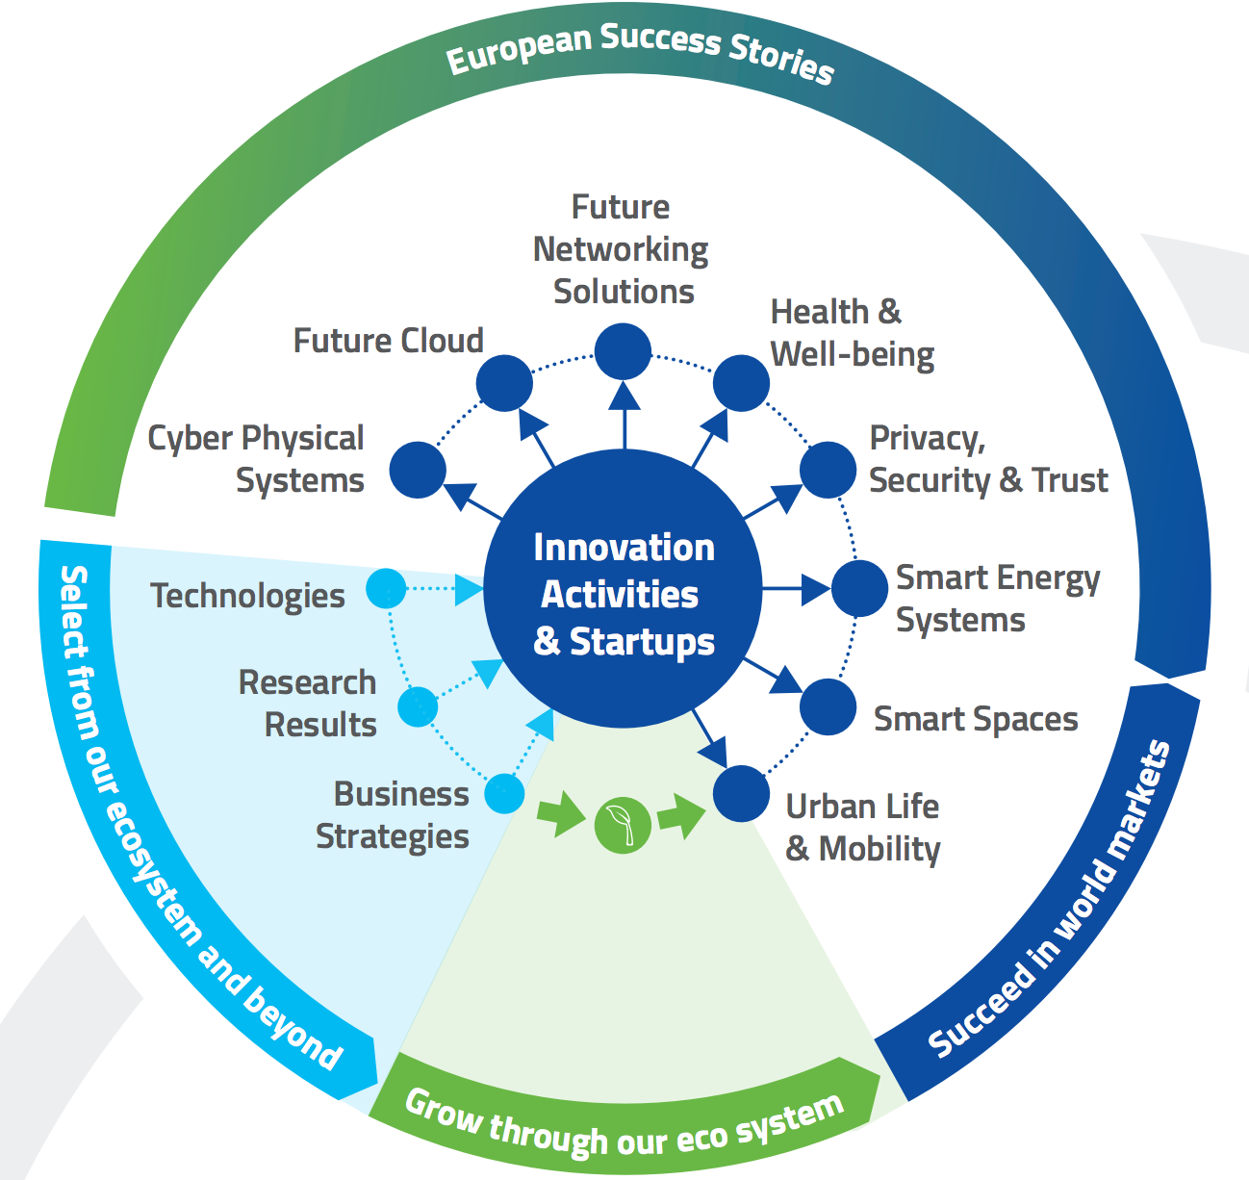
Innovation & Entrepreneurship

Slide 7
EIT Digital in the Bay Area
Programs
Industry Engagement
Innovation & Acceleration
Entrepreneurial Education
Europe as One
SDN/NFV federated testbed & certification service
CityLab for smarter cities
Industrial Internet incubation

Slide 8
EIT Digital & Federated Testbed (1/2)
Testbed is building on wide range of previous and current activities coordinated by EIT Digital, such as SDN at the Edges, and SoftFIRE.
US testbed activity participants from EIT Digital: TIM, Deutsche Telekom, Ericsson, Nokia, Politecnico di Torino, University of Bologna
Collaborations in US with ON.Lab, UC Berkeley (Prof. Scott Shenker), International Computer Science Institute (ICSI), IEEE.
Discussions with AT&T, Cisco, Facebook (and others) on partnership around the testbed.

Slide 9
EIT Digital & Federated Testbed (2/2)
First core of the testbed setup in US become operational at the end of 2015.
Multi-domain controller based on ONOS / OpenStack.
Connect Deutsche Telekom Silicon Valley and JOLnet (TIM) in Italy.
Facilitate collaboration between European and US-based researchers (especially UC Berkeley).
Open the testbed facilities to selected partners in 2016.

Slide 10
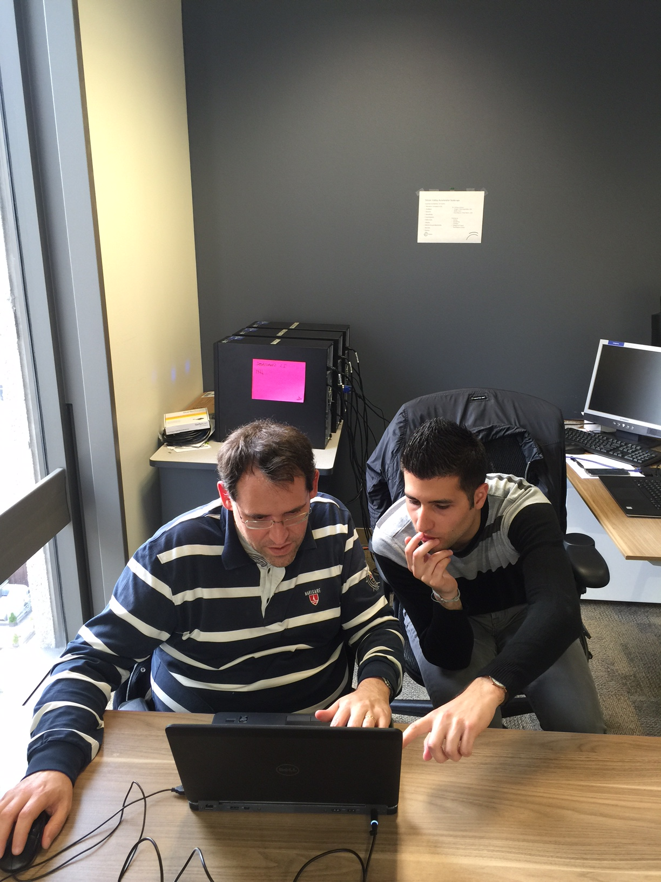

Slide 11
SDN/NFV federated testbed topics (1/2)
Elastic Edge (E2)
NFV promises to bring the advantages of cloud computing to network packet processing.
General management solutions for scaling, placement, fault-tolerance, and SLA-enforcement in an application-agnostic and coherent manner.
E2 advanced prototype, with a wider variety of Network Functions, to be deployed within the context of the SDN testbed.

Slide 12
SDN/NFV federated testbed topics (2/2)
Declarative Infrastructure (DI)
Modern enterprise infrastructures typically involve one or more distributed systems that must be configured to run in the particular underlying physical facility.
DI allows users can specify their desired distributed system in a high-level policy language that handles all the site-specific configuration.
Specify experimental distributed systems for the federated testbed, making it easier to run and share experiments.

